Slide 1
Robotics and IoT Club Secondary Years Level 2 - Week 1
Roohi Banu

Slide 2
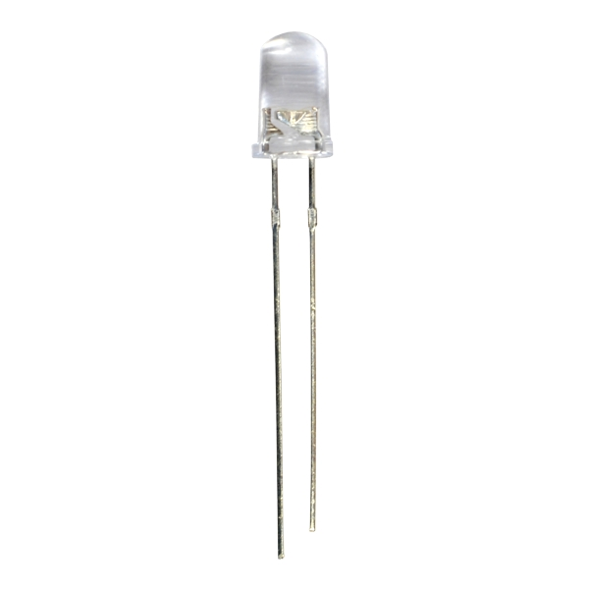
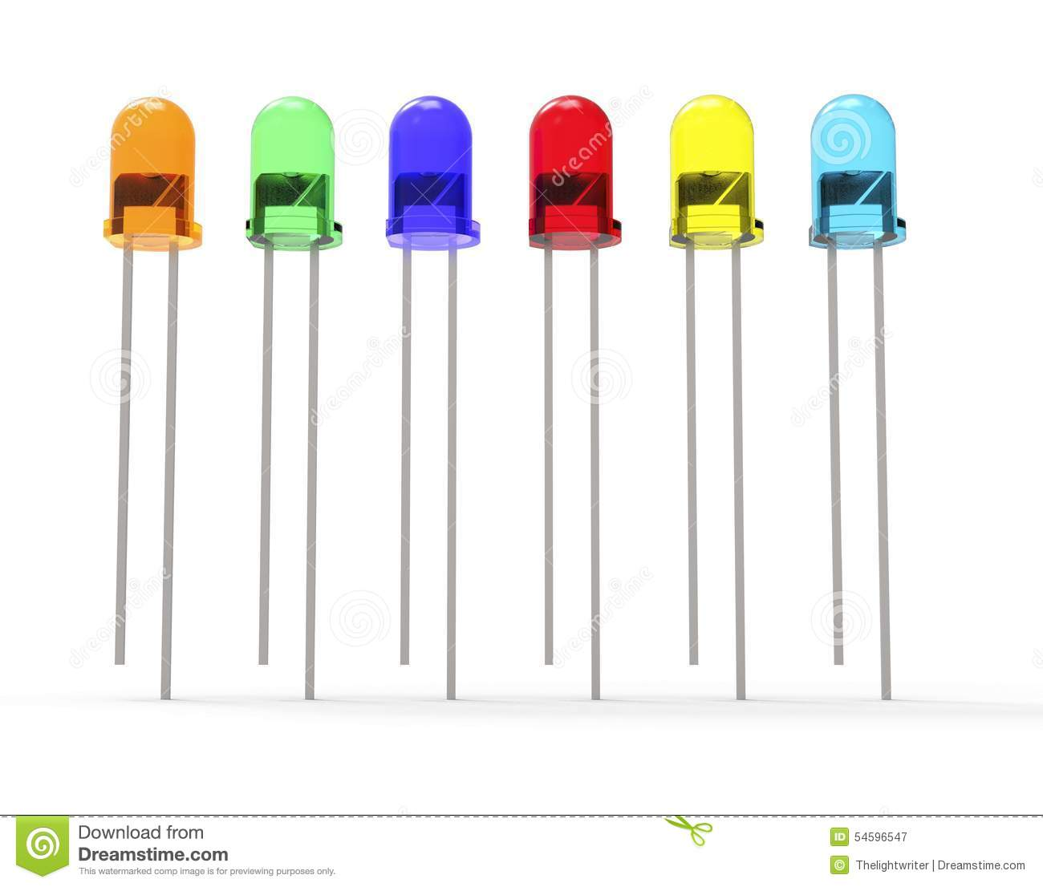
Basic Electronic Components
What is a LED?
Light
Emitting
Diode
LED has one Long leg and one short leg
Short Leg Negative ‘-’
Long Leg Positive ‘+’

Slide 3
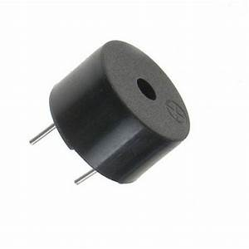
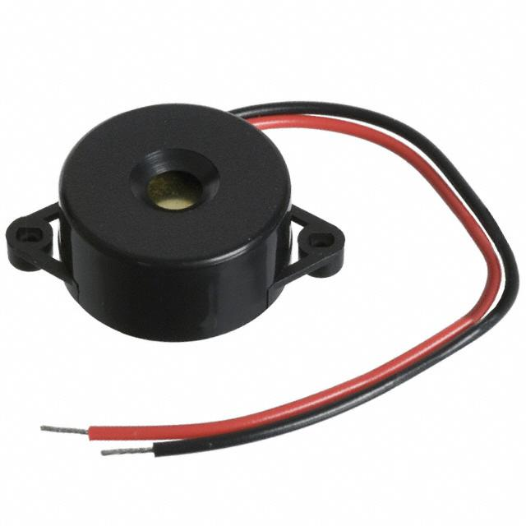
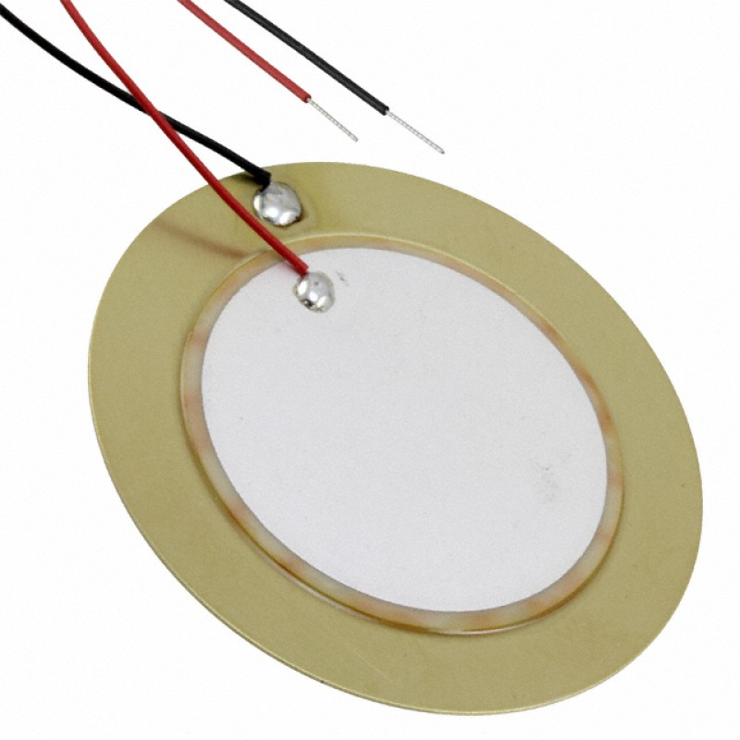
Buzzer
Positive
Negative
Negative
Positive
Positive
Negative

Slide 4
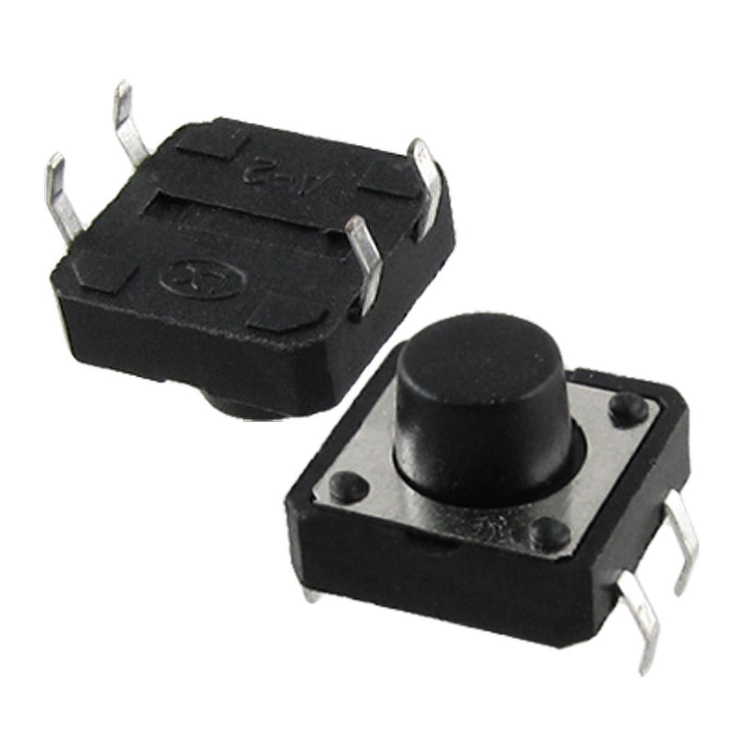
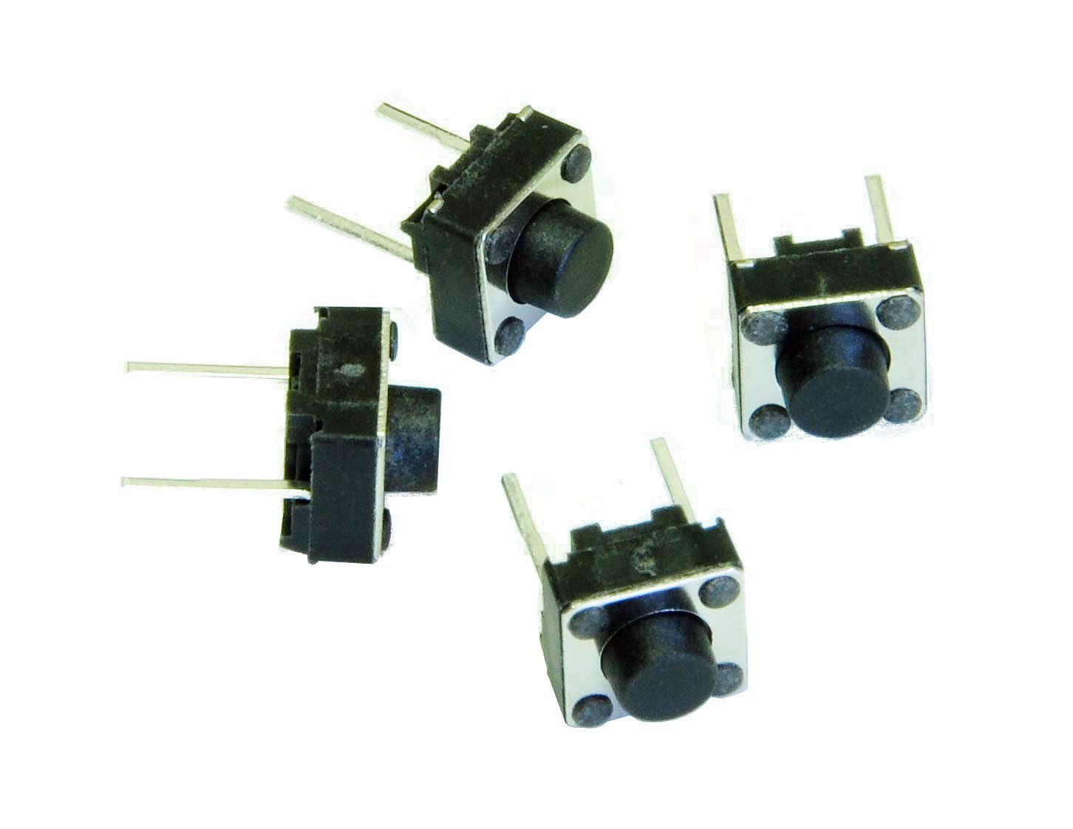
Switch

Slide 5
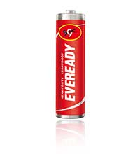
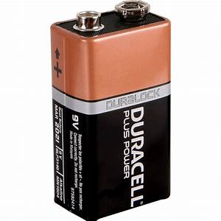
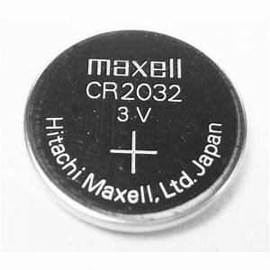
Basic Electronic Components
What is a Battery?
Positive ‘+’
Negative ‘-’
Positive ‘+’
Positive ‘+’
Negative ‘-’
Negative ‘-’

Slide 6
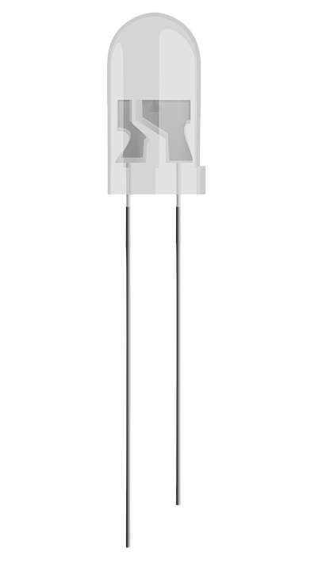
LED and Battery Circuit
Rules
The LED should be positioned vertically
The battery should be placed on either side of the bread board on the positive, negative rails.
The wires should be connected from the row of the positive side of the battery to the column of the positive side of the LED. Similarly negative side of the LED to the negative side of the battery.
Long leg -Positive
Short leg - negative
Negative
Wires
Positive

Slide 7
LED, Battery and Switch
Rules
The LED should be positioned vertically
The battery should be placed on either side of the bread board on the positive, negative rails.
The wires should be connected from the row of the positive side of the battery to the column of the positive side of the LED. Similarly negative side of the LED to the negative side of the battery.
The switch doesn't have positive and negative. You can connect the wires to the columns of switch
Long leg - positive
Short leg - Negative
Negative
Positve

Slide 8
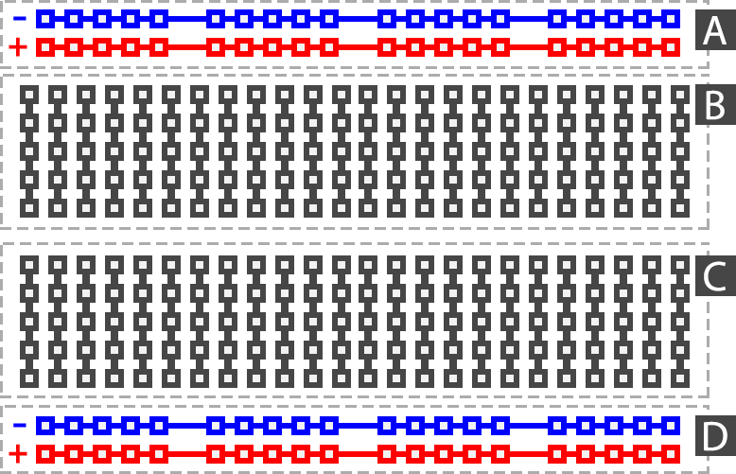
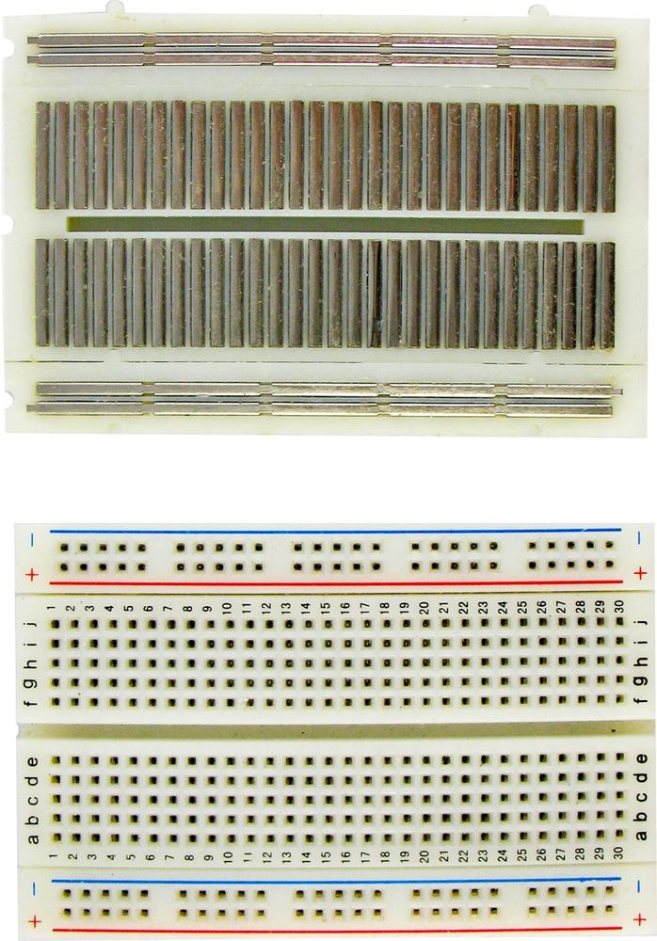
Bread Board
Row
Column

Slide 9
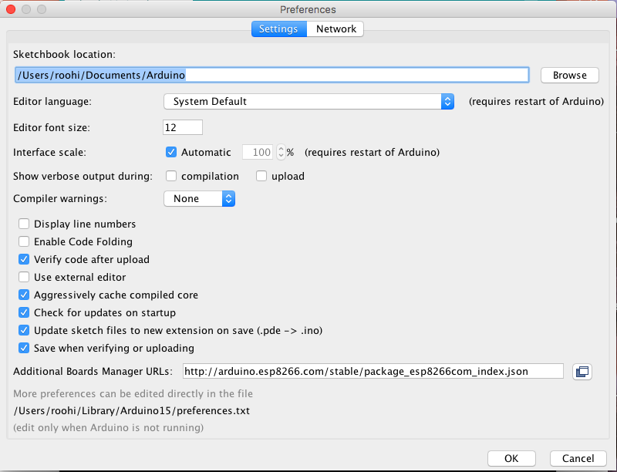
Arduino Programming – Folder Structure
Create a folder ‘Arduino’ in your working area.
Keep all your programs (Sketches) in this folder
/Users/roohi/Documents/Arduino
Create a folder ‘libraries’ inside Arduino
Folder
/Users/roohi/Documents/Arduino/libraries

Slide 10
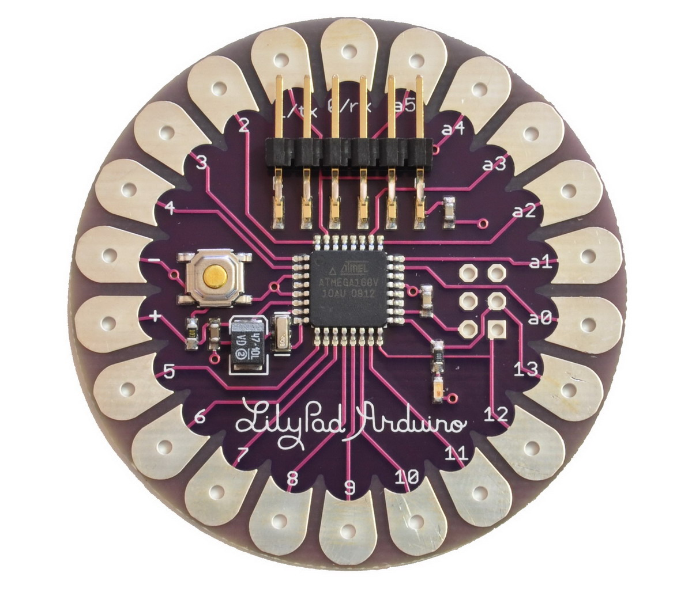
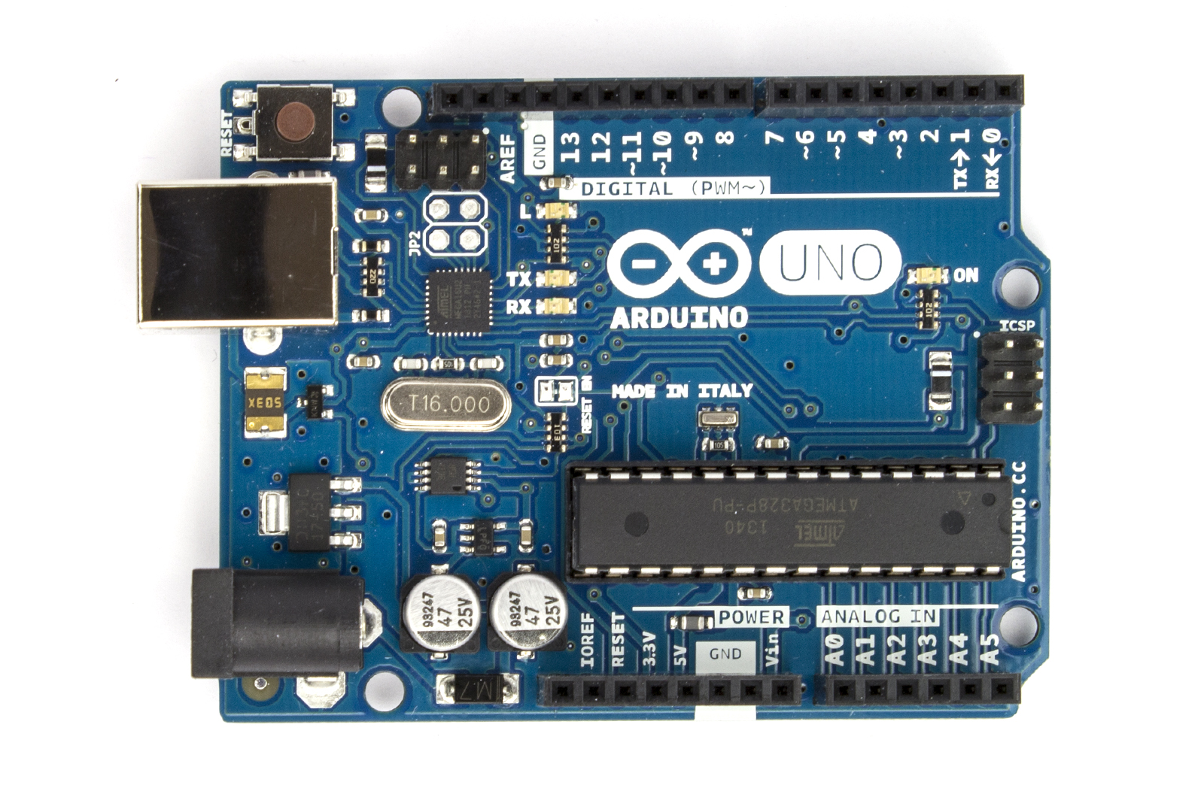
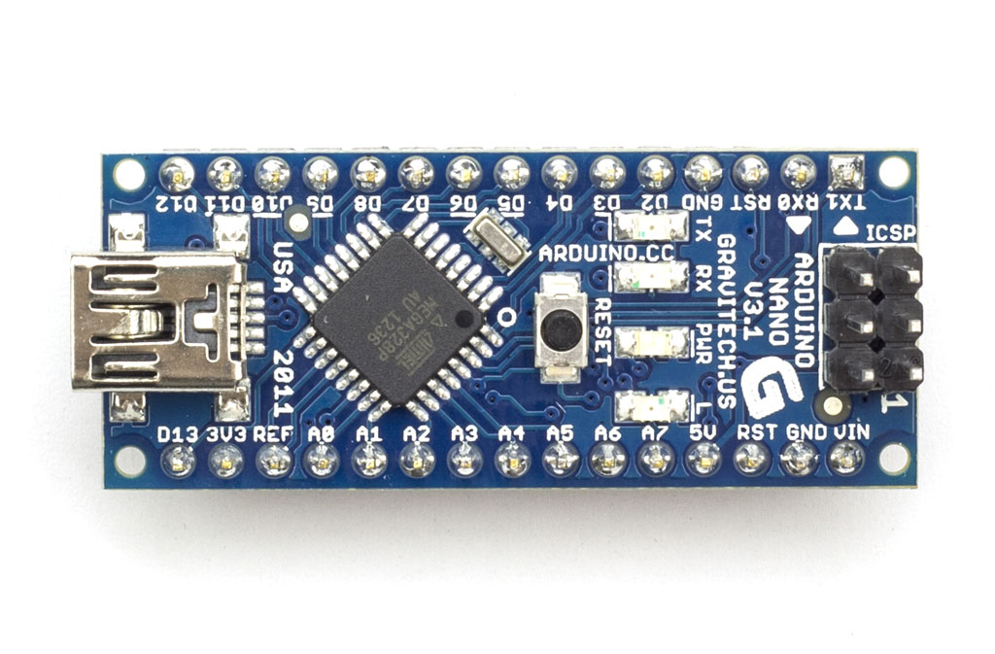
ARDUINO
Arduino is a Micro Controller like BBC Microbit – Small Computer
Very popular and widely used microcontroller
How does it look?
UNO
NANO
LILYPAD

Slide 11
What can we do with Arduino?
We can not only MONITOR ‘Things’ but can CONTROL ’Things’!
So, what are ‘Things?’
Goods
Objects
Machines
Appliances
Buildings
Vehicles
Animals
People
Plants
Soil

Slide 12

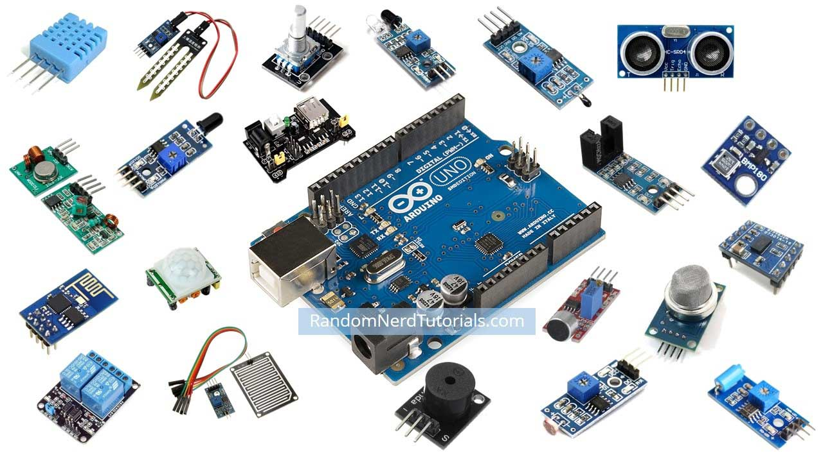
How do we monitor and control things?
Humans use ‘senses’ to monitor things.
We use our ‘brain’ to control things.

Slide 13
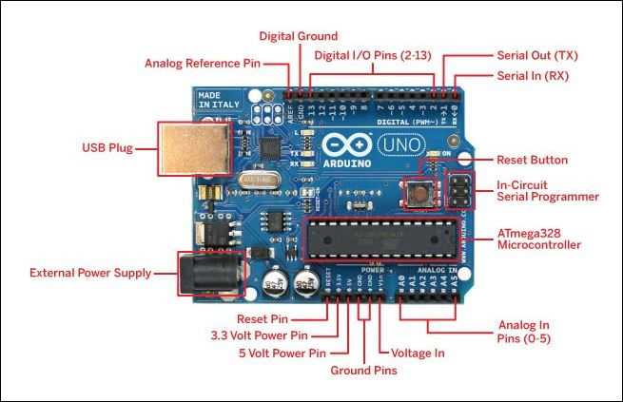
ARDUINO UNO

Slide 14
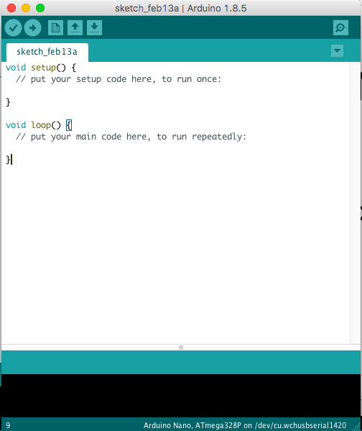
ARDUINO IDE – Browser

Slide 15
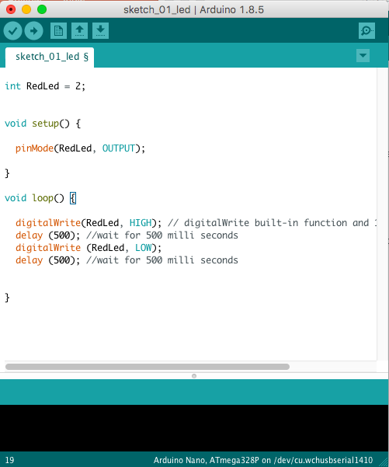
Arduino – Sketch 02 – Control Single LED -Variable

Slide 16
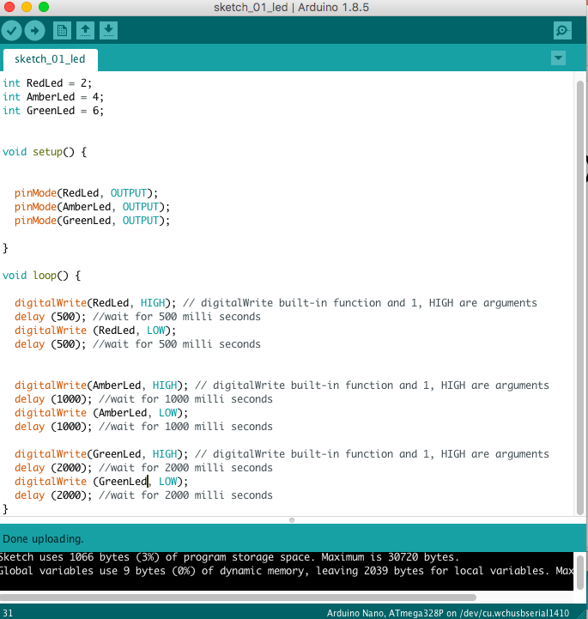
Arduino – Sketch 03 - Variables

Slide 17
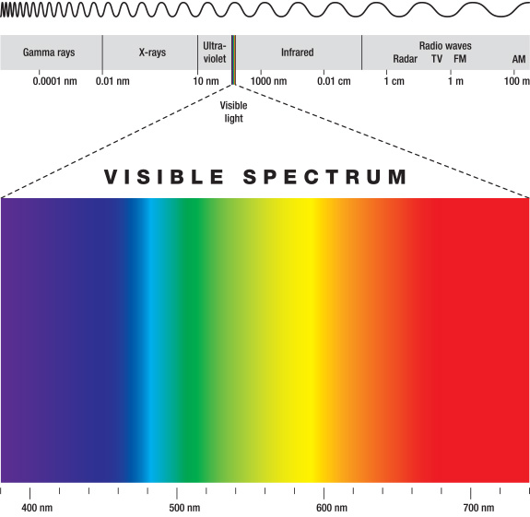
Communications – Infra Red (IR)
IR Remote Controls
How does it work?
IR Remote Controls use
light to transmit data
Light used is IR

Slide 18
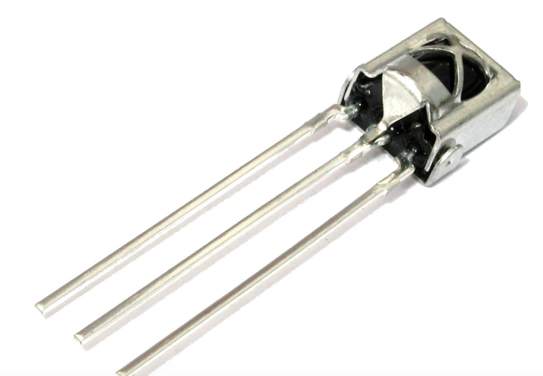
Communications – Infra Red (IR)
Library - IR Remote
SIGNAL
GND
3.3V

Slide 19
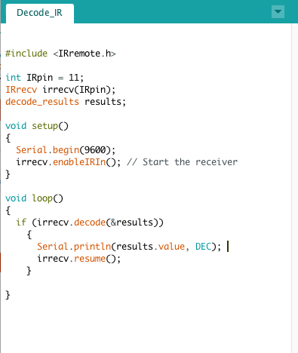
Decode IR

Slide 20
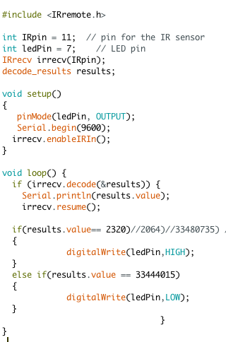
Controlling LED Using IR

Slide 21
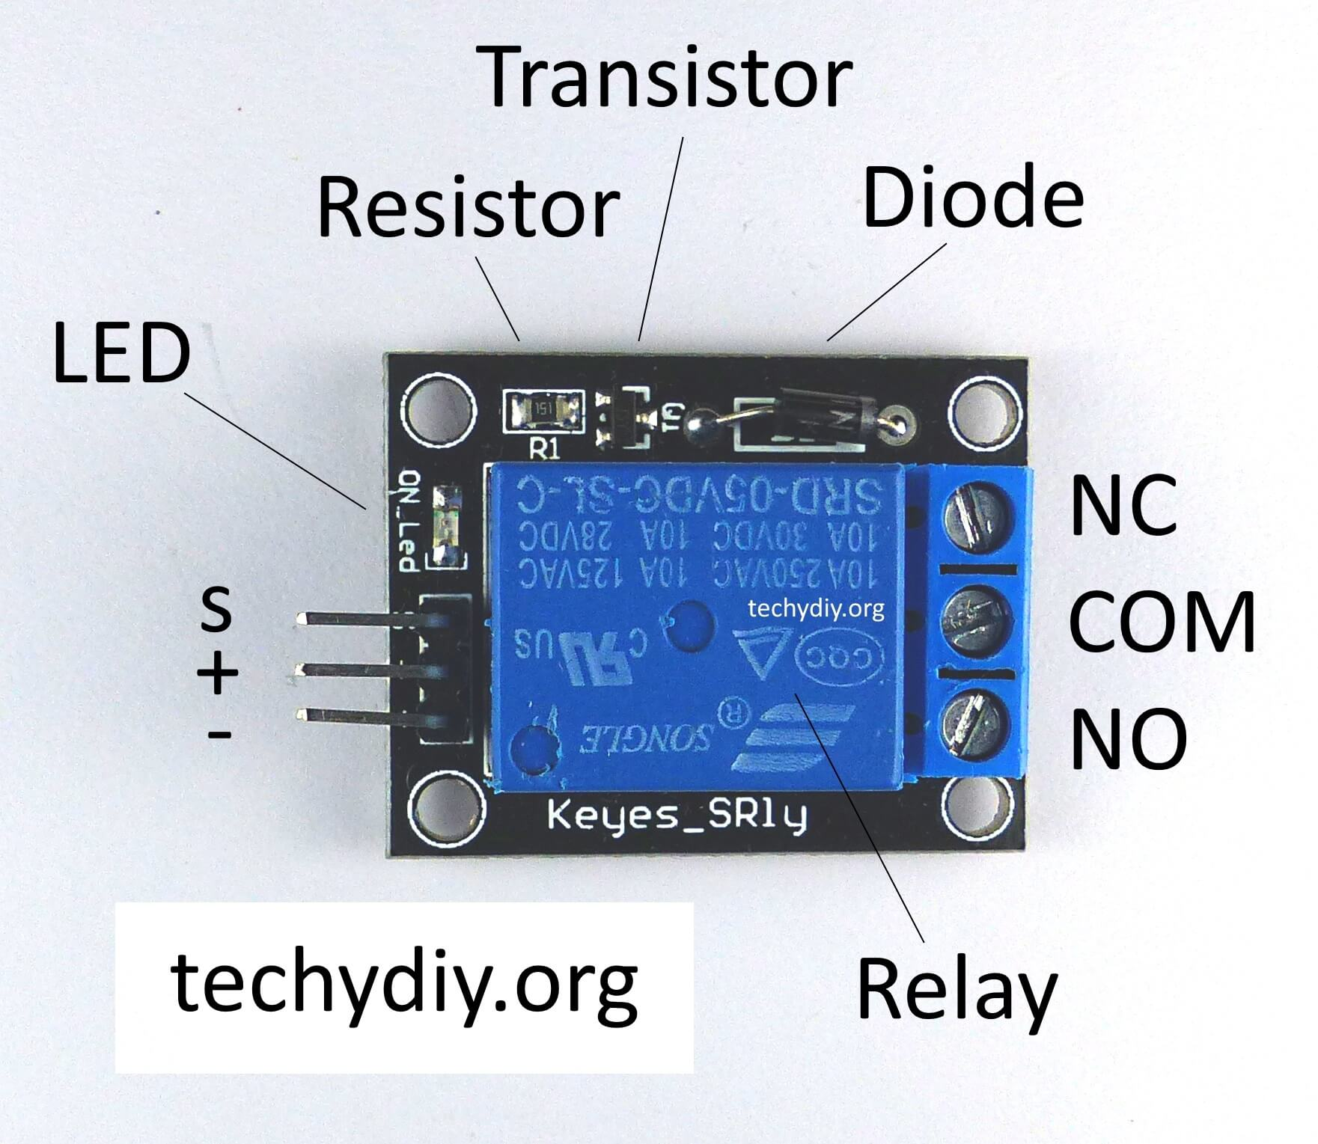
Relay
It is used to control high voltage electronic appliances
It is a switch which is electrically operated

Slide 22
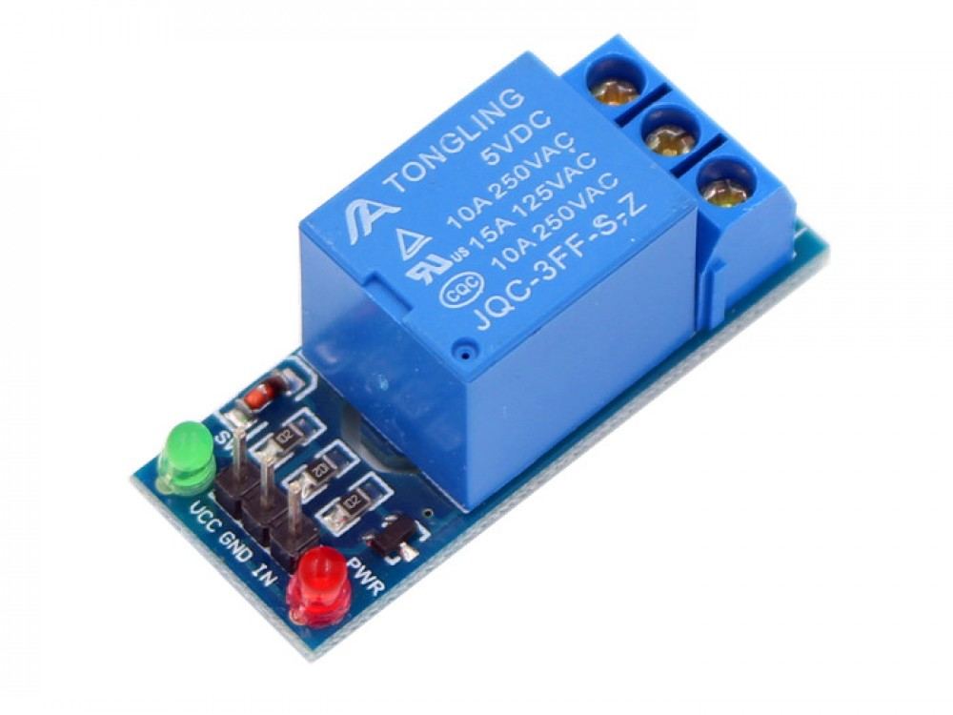
LED, Battery and Switch
2nd Circuit
High Voltage Circuit
Arduino
Low Voltage Circuit

Slide 23
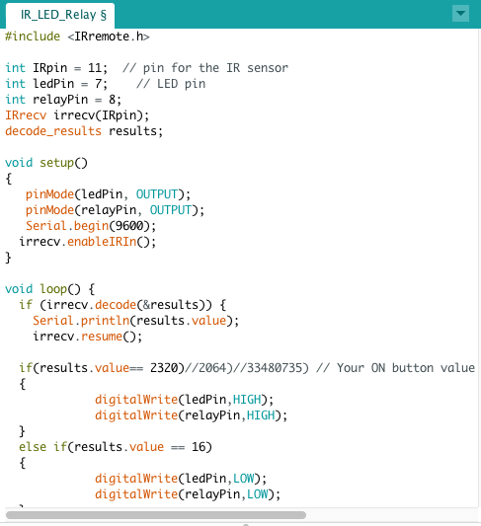
Controlling Relay Using IR

Slide 24
Projects to try at home…..
Control couple of LEDs/Buzzers using your TV/DVD Player remote
Control your Servo motor using remote control
How to control the Fans or Tube Lights using remote?
Can you think of controlling all the electrical appliances using remote in your room?
Think of how to control your car using IR remote.

